Slide 1

MINIMALIST
GRAYSCALE
PITCH DECK
Here is where your presentation begins

Slide 2

Contents of this template
Here’s what you’ll find in this minmallist template:
1. A slide structure based on a pitch deck presentation which you can easily adapt to your
needs. For more info on how to edit the template, please visit minmallist School or read
our FAQs.
2. To view this template with the correct fonts in ppt format, download and install on your
computer the fonts that we have used. You can learn how to download and install fonts
here.
3. An assortment of infographic resources that are suitable for use in the presentation can be
found in the alternative resources slide.
4. A thanks slide, which you must keep so that proper credits for our design are given.
5. Two resources slides, where you’ll find links to all the elements used in the template.
6. Instructions for use.
7. Final slides with:
●
●
The fonts and colors used in the template.
A selection of illustrations. You can also customize and animate them as you wish
with the online editor. Visit Storyset to find more.
●
●
More infographic resources, whose size and color can be edited.
Sets of customizable icons of the following themes: general, business, avatar,
creative process, education, help & support, medical, nature, performing arts, SEO
& marketing, and teamwork.
You can delete this slide when you’re done editing the presentation.

Slide 3

whoa!
This can be the part of the presentation where you
introduce yourself, write your email...

Slide 4
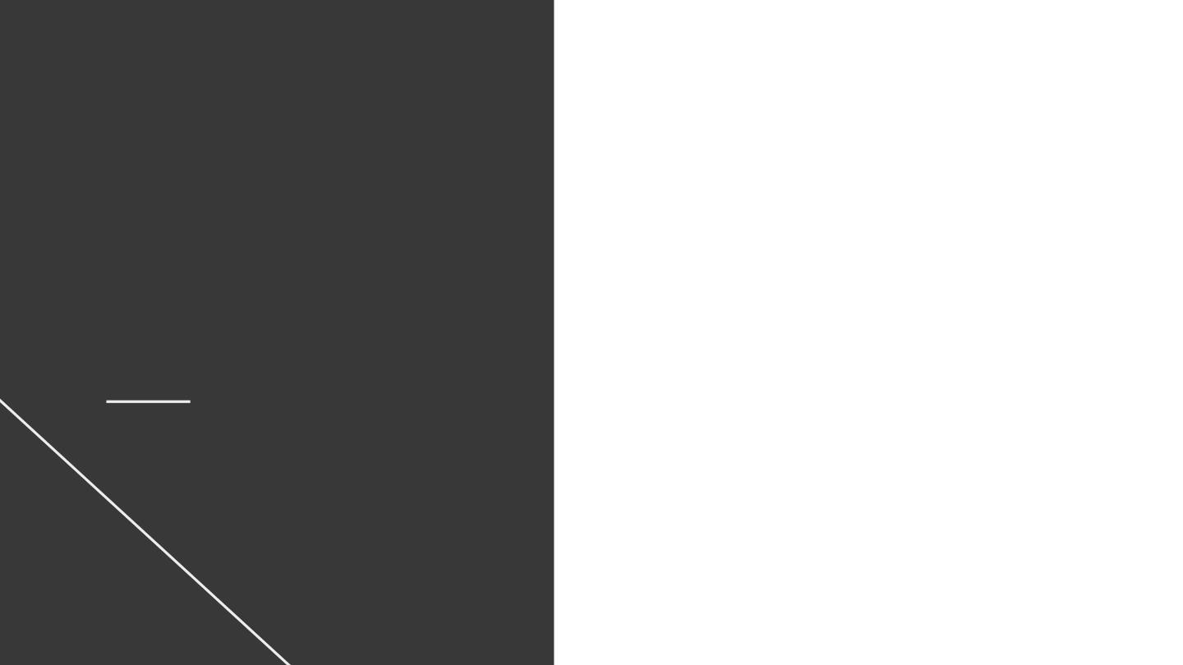
01
02
03
04
Problem vs. Solution
Topic of the section
Product
Table of contents
Topic of the section
Market & competition
Topic of the section
Business Model
Topic of the section

Slide 5

Table of contents
01
02
Problem vs. Solution
03
04
Market & Competition
Topic of the section
Topic of the section
Product
Business Model
Topic of the section
Topic of the section

Slide 6

01
Problem vs.
Solution
Enter a subtitle here if
you need it

Slide 7
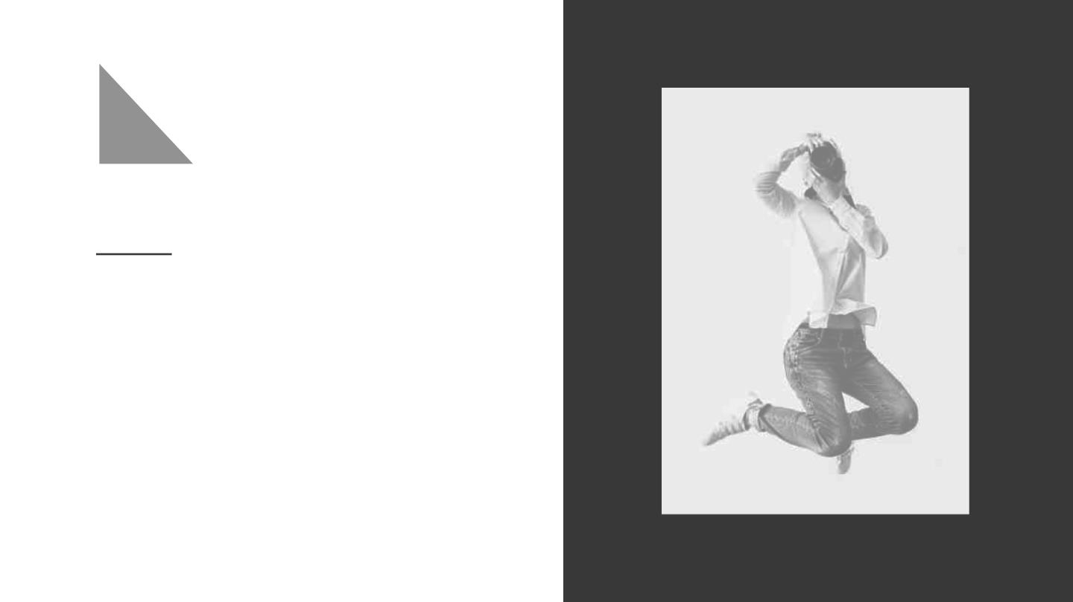
Introduction
Mercury is the closest planet to the Sun
and the smallest one in the Solar
System—it’s only a bit larger than the
Moon. The planet’s name has nothing to
do with the liquid metal

Slide 8
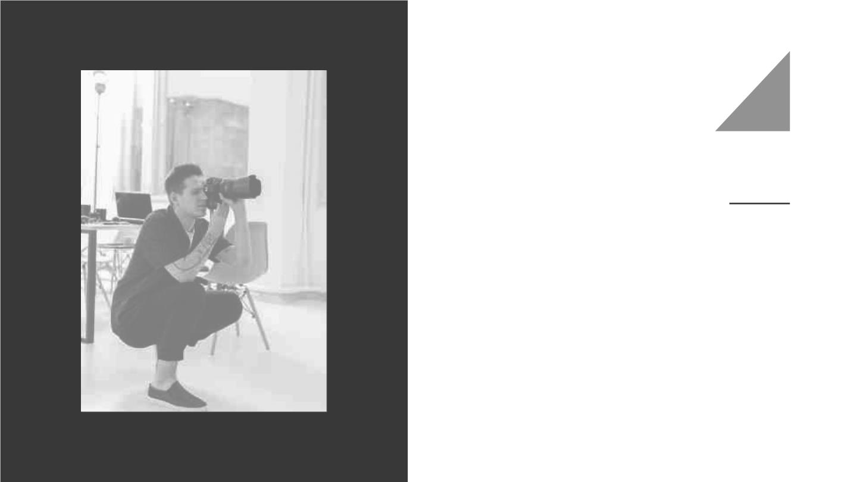
Introduction
Mercury is the closest planet to the Sun
and the smallest one in the Solar
System—it’s only a bit larger than the
Moon. The planet’s name has nothing to
do with the liquid metal

Slide 9

Our company
Do you know what helps you make your point
clear? Lists like this one:
● They’re simple
● You can organize your ideas clearly
● You’ll never forget to buy milk!

Slide 10

Our company
Do you know what helps you make your point
clear? Lists like this one:
● They’re simple
● You can organize your ideas clearly
● You’ll never forget to buy milk!

Slide 11
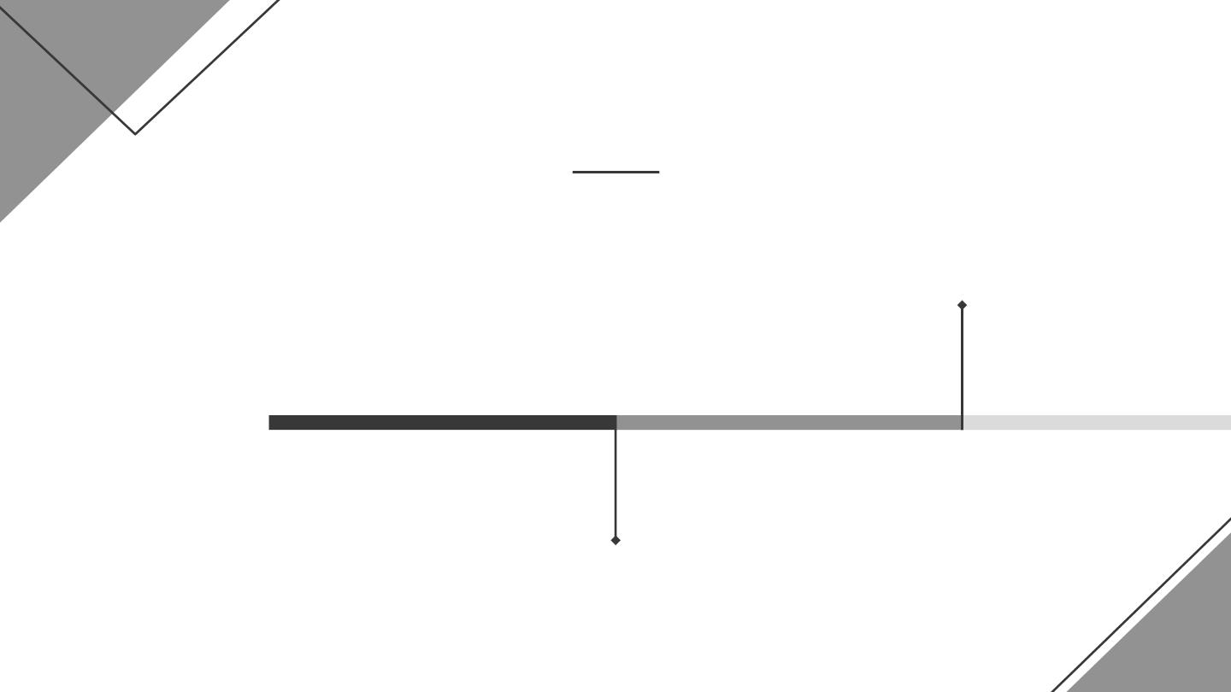
Our evolution
2010
Jupiter is the biggest
planet in the Solar System
Venus has a beautiful
name, but it’s terribly hot
2005

Slide 12
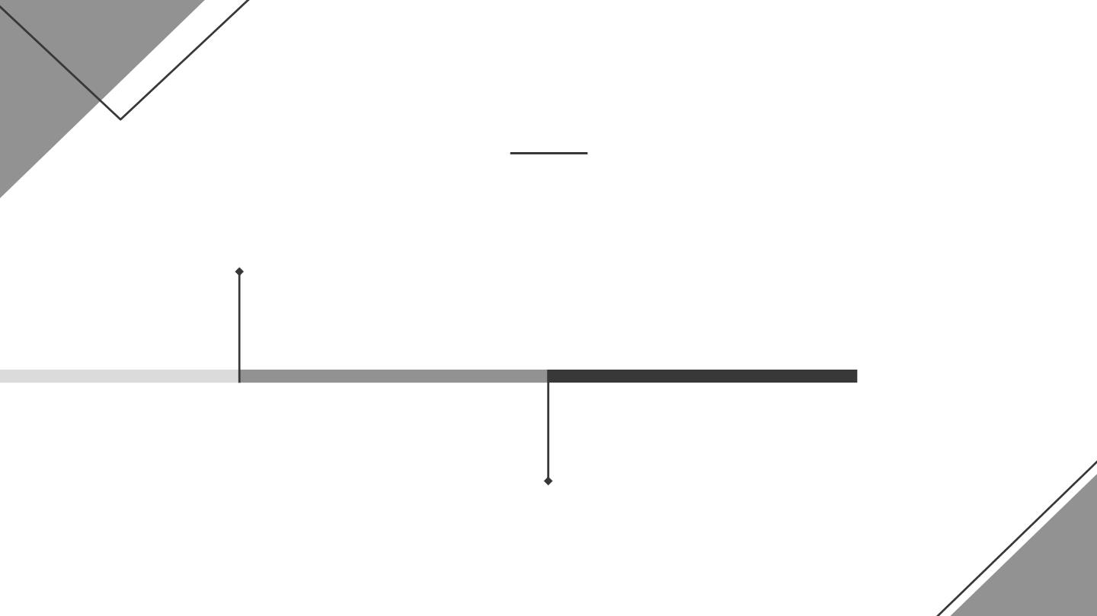
Our evolution
2015
Despite being red, Mars is
a cold place, not hot
Jupiter is a gas giant and
the biggest planet
2020

Slide 13
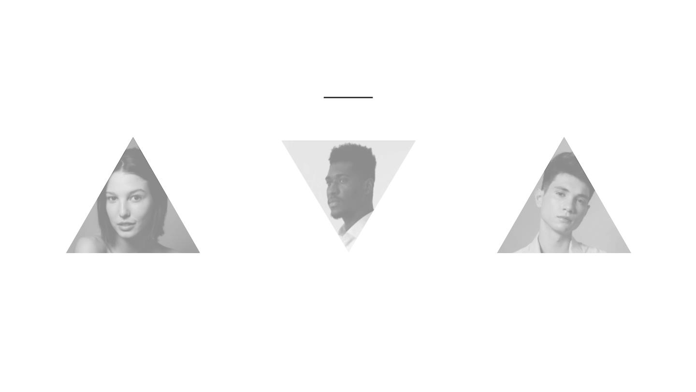
Our team
Lyssa Turner
Peter Rose
John Dublin
You can replace the
image on the screen
with your own
You can replace the
image on the screen
with your own
You can replace the
image on the screen
with your own

Slide 14

Problem
Mercury is the closest planet to the Sun and the smallest
one in the Solar System—it’s only a bit larger than the
Moon. The planet’s name has nothing to do with the
liquid metal

Slide 15

Them
Us
Mercury is the closest planet to the
Sun and the smallest one in the
Solar System. Mercury’s name has
nothing to do with the liquid metal
Venus has a beautiful name and is
the second planet from the Sun. It’s
terribly hot—even hotter than
Mercury. It’s extremely poisonous

Slide 16

Them
Mercury is the closest planet to the
Sun and the smallest one in the
Solar System. Mercury’s name has
nothing to do with the liquid metal
Us
Venus has a beautiful name and is
the second planet from the Sun. It’s
terribly hot—even hotter than
Mercury. It’s extremely poisonous

Slide 17

Solution
Mercury is the closest planet to the
Sun and the smallest one in the
Solar System. The planet’s name
has nothing to do with the liquid
metal

Slide 18

Solution
Mercury is the closest planet to the
Sun and the smallest one in the
Solar System. The planet’s name
has nothing to do with the liquid
metal

Slide 19

02
Product
Enter a subtitle here if you need
it

Slide 20
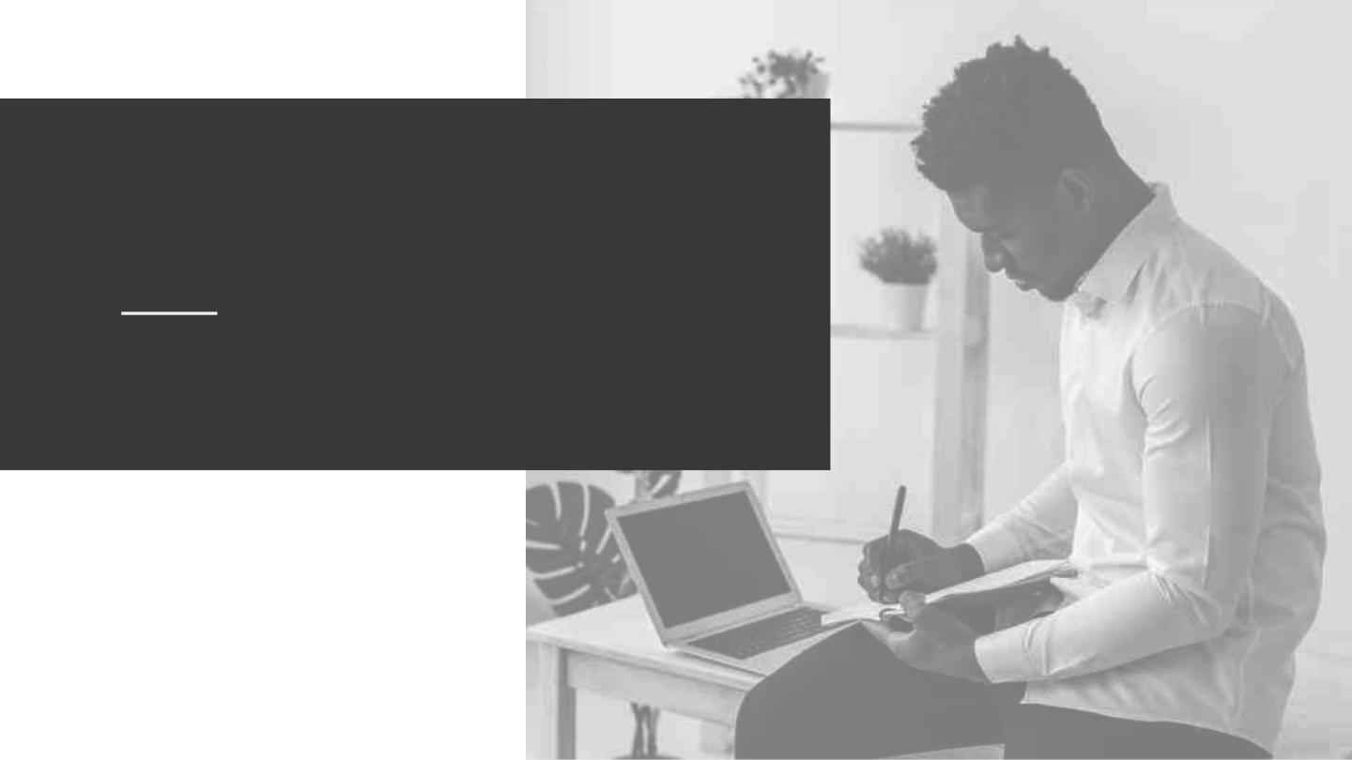
An image is worth a
thousand words
Images reveal large amounts of data, so
remember: use an image instead of a long text

Slide 21

An image is worth a
thousand words
Images reveal large amounts of data, so remember:
use an image instead of a long text

Slide 22

AWESOME WORDS

Slide 23

Awesome
words

Slide 24
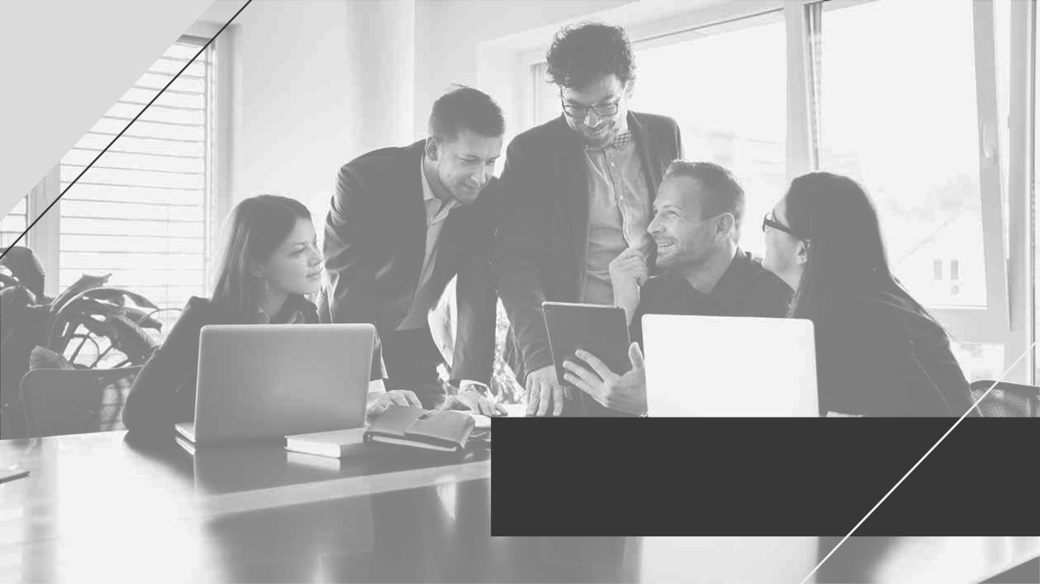
A picture is worth a
thousand words

Slide 25

A picture is worth a
thousand words

Slide 26
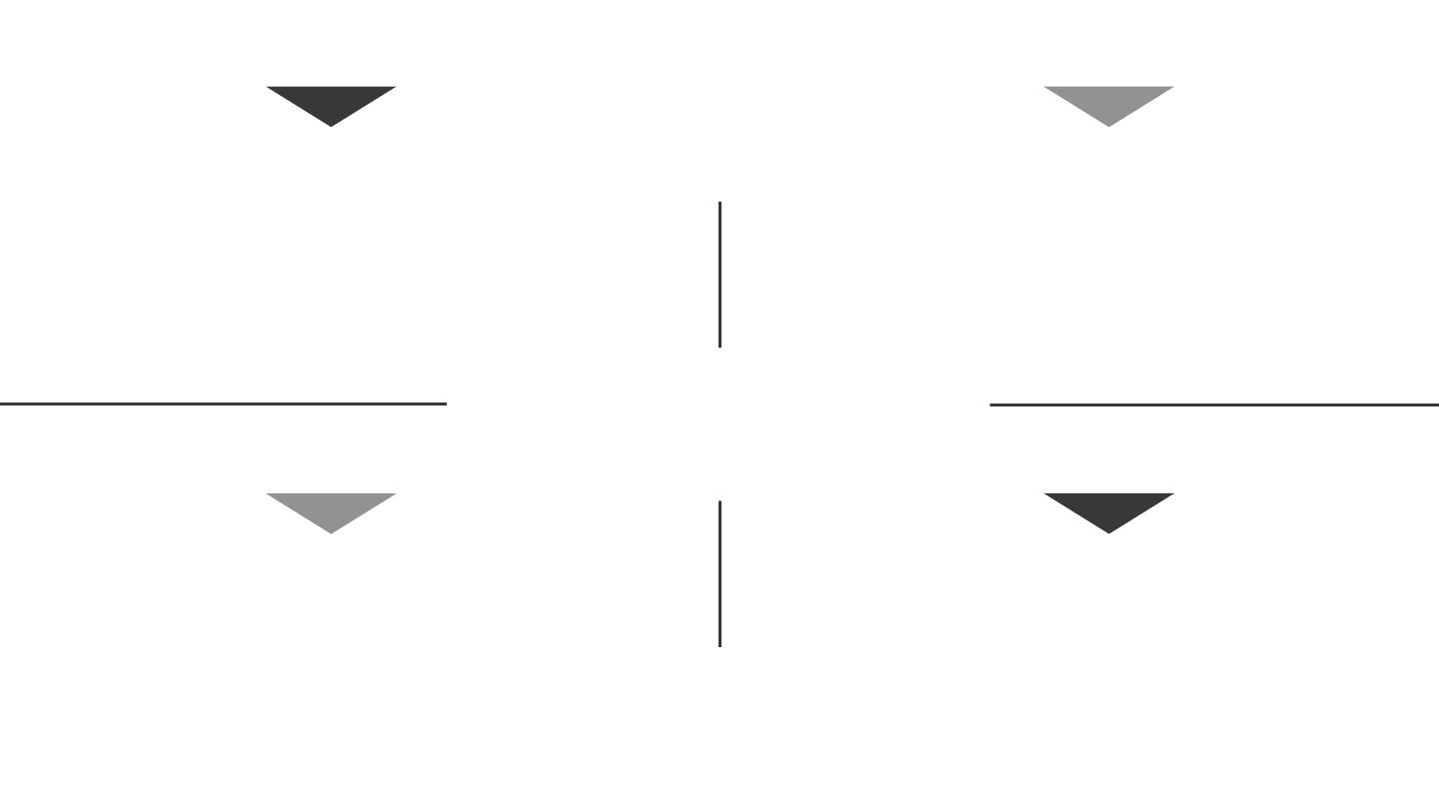
Strengths
Opportunities
Despite being red, Mars is
actually a very cold place. It’s
full of iron oxide dust
Jupiter is a gas giant
and the biggest planet
in the Solar System
SWOT
Weaknesses
Threats
Mercury is the closest planet
to the Sun and the smallest
one in the Solar System
Saturn is a gas giant,
composed mostly of
hydrogen and helium

Slide 27

SWOT
Strengths
Opportunities
Despite being red, Mars
is actually a very cold
place
Jupiter is the biggest
planet in the Solar
System
Weaknesses
Threats
Mercury is the closest
planet to the Sun
Saturn is composed
mostly of hydrogen and
helium

Slide 28

03
Market &
Competition
Enter a subtitle here if
you need it

Slide 29
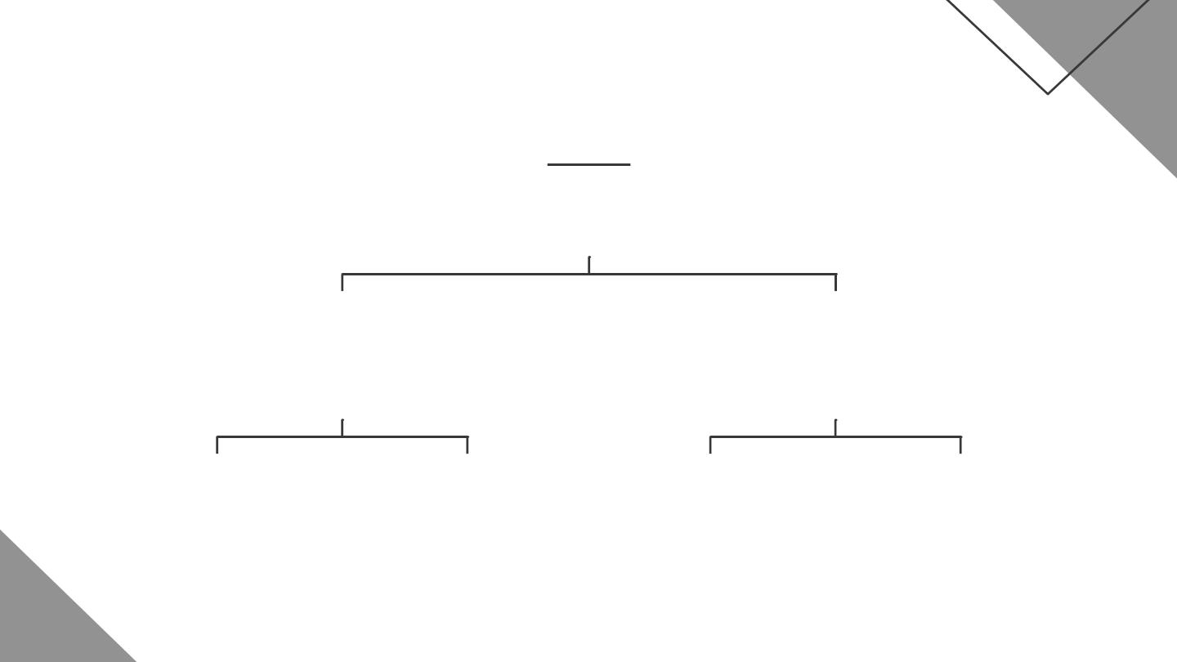
Strategy
Goal
Key Action 1
Key Action 2
Saturn is a gas
giant with rings
Neptune is far away
from Earth
Venus
Mars
JUPITER
Mercury
Venus has a
beautiful name
Despite being red,
Mars is a cold place
Jupiter is the
biggest planet
Mercury is the
smallest planet

Slide 30
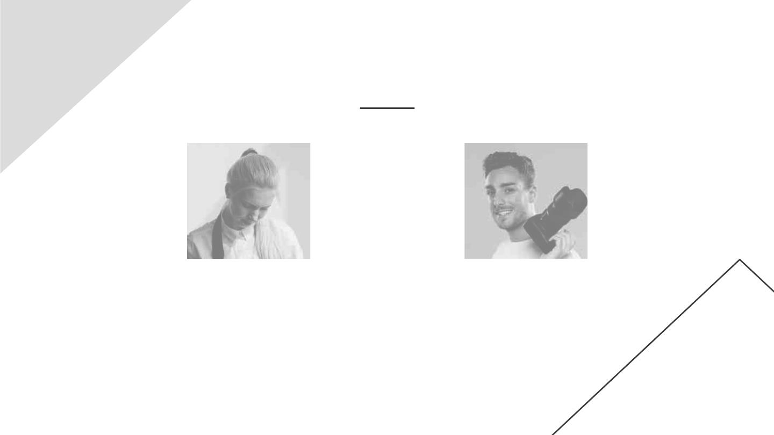
Our services
Planning
Photography
Venus is the second planet
from the Sun
Saturn is a gas giant and
has several rings

Slide 31

Our plans
Basic
Pro
Premium
Despite being red, Mars is
actually cold place
Saturn is composed mostly
of hydrogen and helium
Jupiter is a gas giant and
the biggest planet

Slide 32
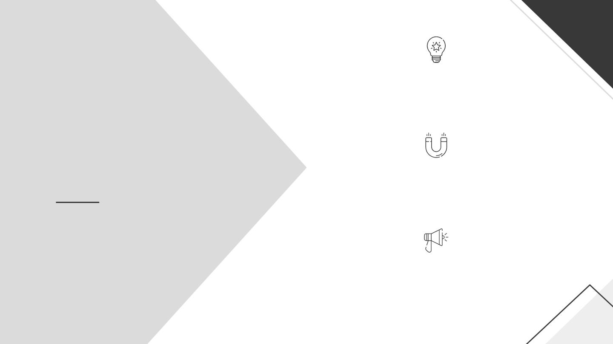
BASIC
Despite being red, Mars is
actually cold place
Our plans
PRO
Saturn is composed mostly
of hydrogen and helium
PREMIUM
Jupiter is a gas giant and
the biggest planet

Slide 33
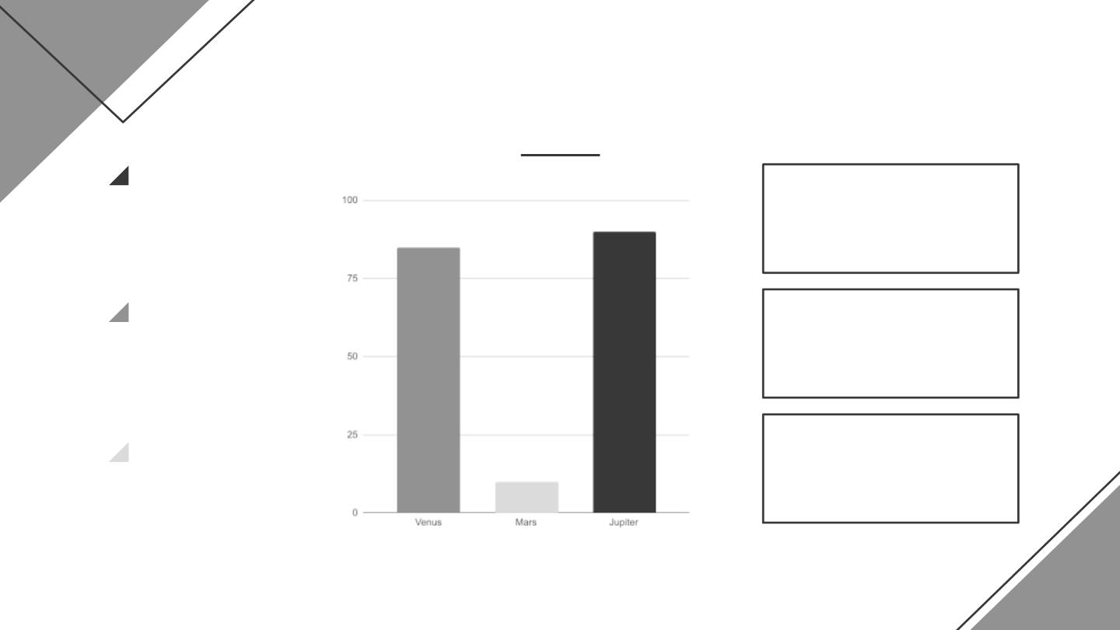
Trend
People
90%
458K
Mercury is a
small planet
85%
Neptune is an ice giant
Sales
$7,520,000
Mars is a very
cold place
Uranus is an ice giant
Market
10%
86%
Jupiter is a
gas giant
Mars is a very cold
place
Follow the link in the graph to modify its data and then paste the new one here. For more info, click here

Slide 34
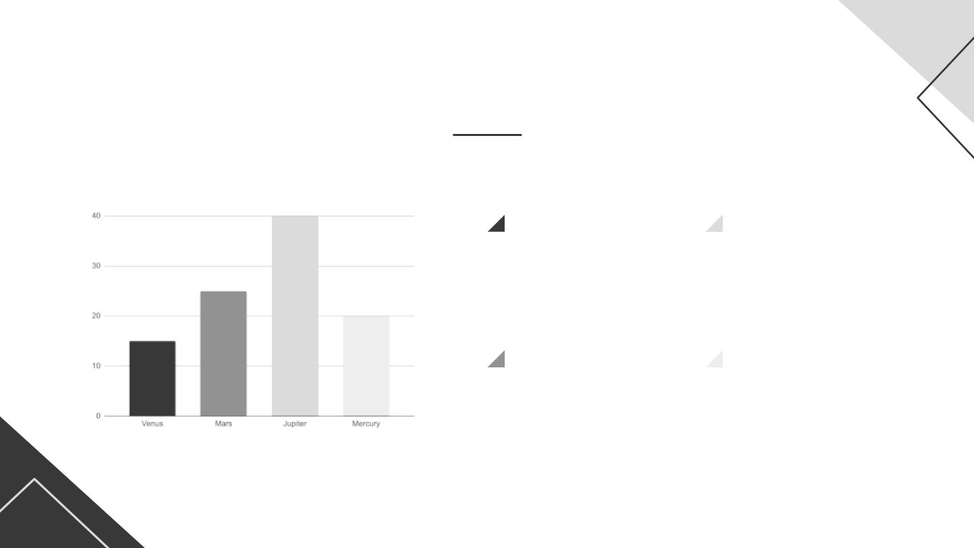
Trend
Venus
Jupiter
Venus has a
nice name
Jupiter is a
gas giant
Mars
Mercury
Mars is a very
cold place
Mercury is a
small planet
Follow the link in the graph to modify its data and then paste the new one here. For more info, click here

Slide 35
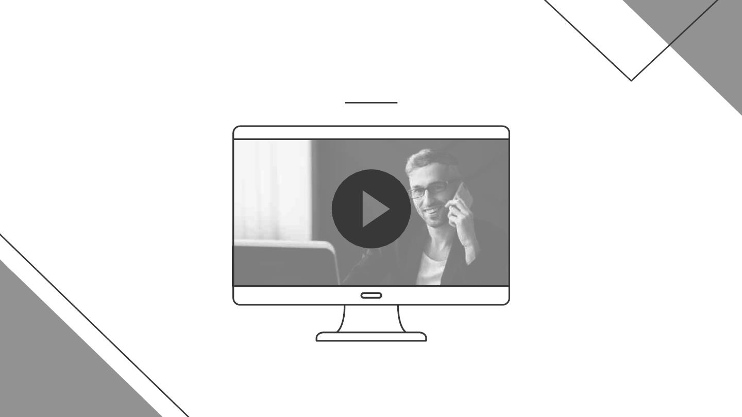
Product demo
Insert your multimedia content here

Slide 36

Product demo
Insert your multimedia content here

Slide 37
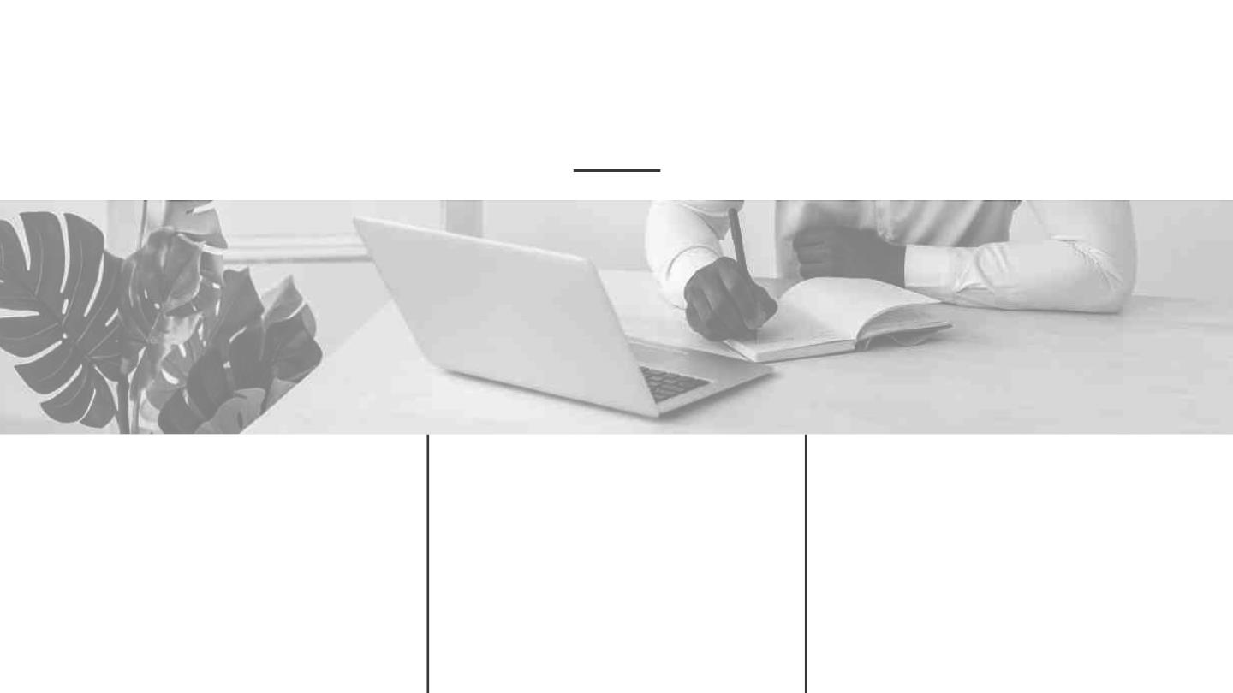
Case study
Challenge
Results
Solution
Despite being red, Mars
is a cold place. It’s full of
iron oxide dust
Jupiter is a gas giant
and the biggest planet in
the Solar System
Venus has a beautiful
name and is the second
planet from the Sun

Slide 38
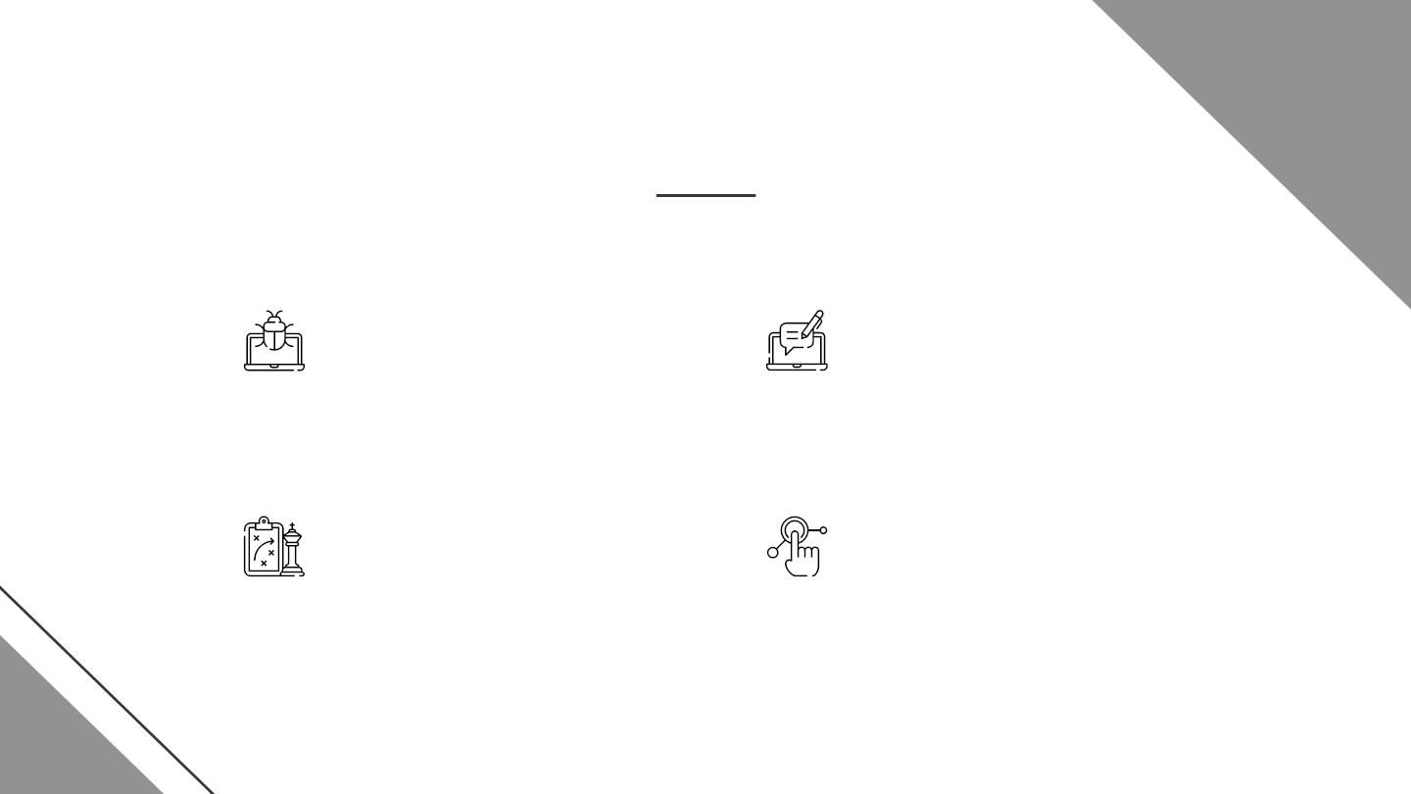
Case study
PROBLEM
RESULTS
Despite being red, Mars
is actually a very cold
place
Venus has a beautiful
name but it’s terribly hot
CHALLENGE
SOLUTION
Jupiter is a gas giant and
the biggest planet
Mercury is the closest
planet to the Sun

Slide 39
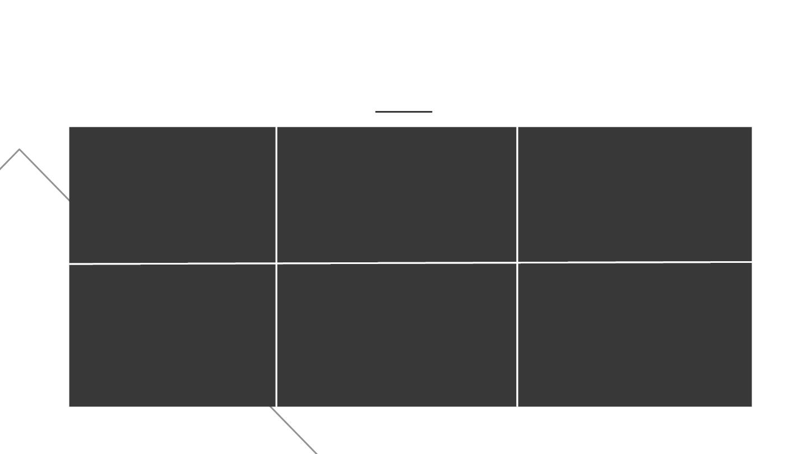
Reviews
Helena James
Jenna Doe
John Smith
Mercury is the
smallest planet
Venus has a very
beautiful name
Despite being red,
Mars is cold
Jessica Jones
Peter Harris
Maria Wilson
Jupiter is the biggest
planet of them all
Saturn is a gas giant
with several rings
Neptune is far away
from Earth

Slide 40
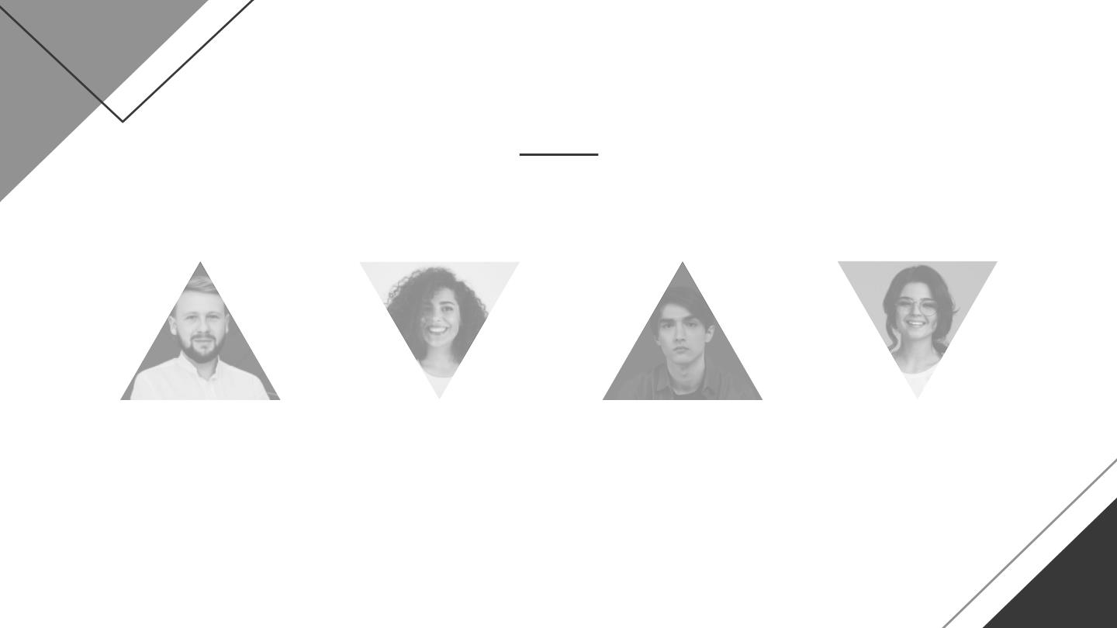
Reviews
Tom James
Jenna Doe
John Smith
Jessica Jones
Jupiter is the biggest
planet of them all
Venus has a very
beautiful name
Mercury is the
smallest planet
Neptune is far away
from Earth

Slide 41
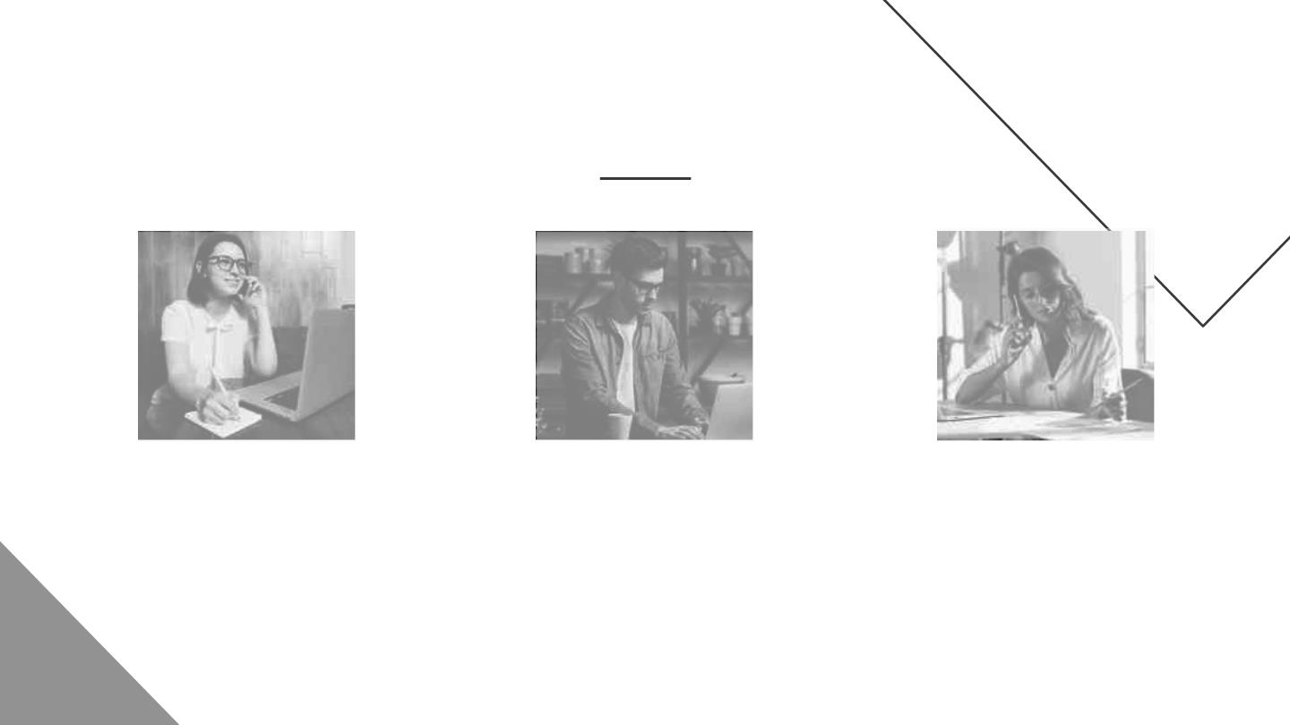
2020 awards
Mercury
Venus
Mars
Mercury is the closest
planet to the Sun and the
smallest one
Venus has a beautiful name
and is the second planet
from the Sun
Despite being red, Mars is
actually a cold place. It’s full
of iron oxide dust

Slide 42

04
Business model
Enter a subtitle here if you need
it

Slide 43
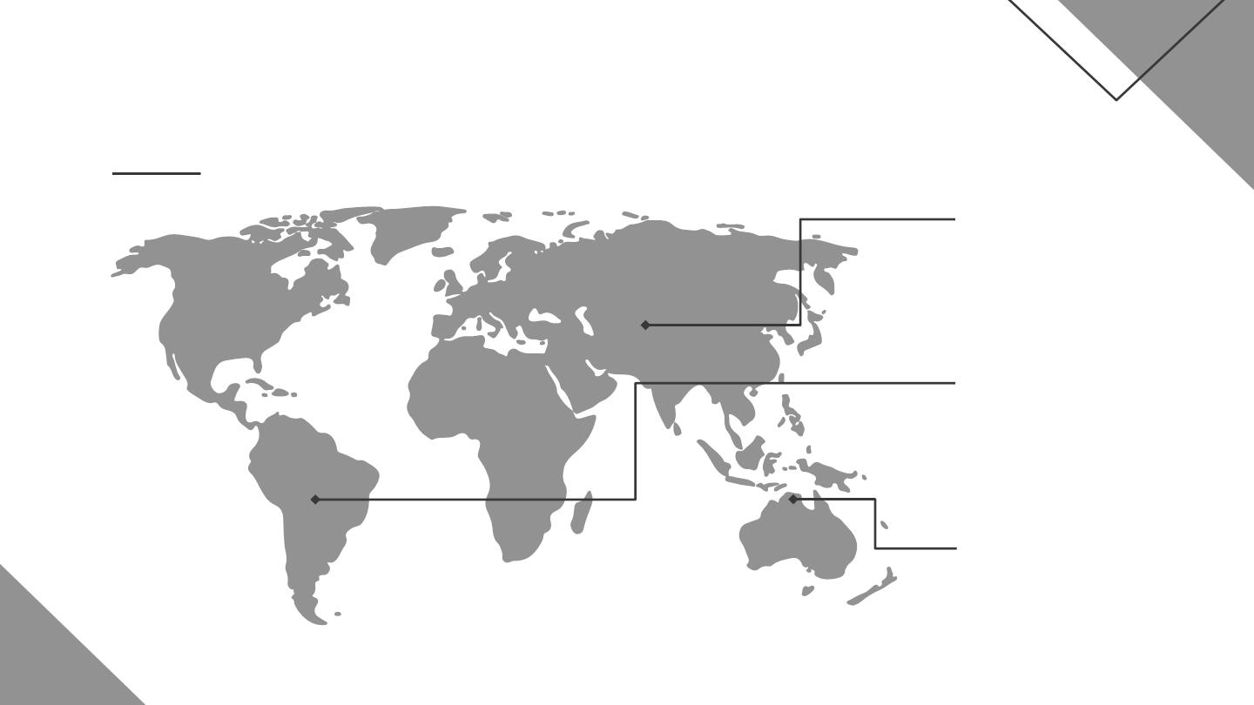
Market size
Mercury
It’s the closest
planet to the
Sun
Mars
Despite being
red, it’s cold
Venus
Venus has a
beautiful name

Slide 44
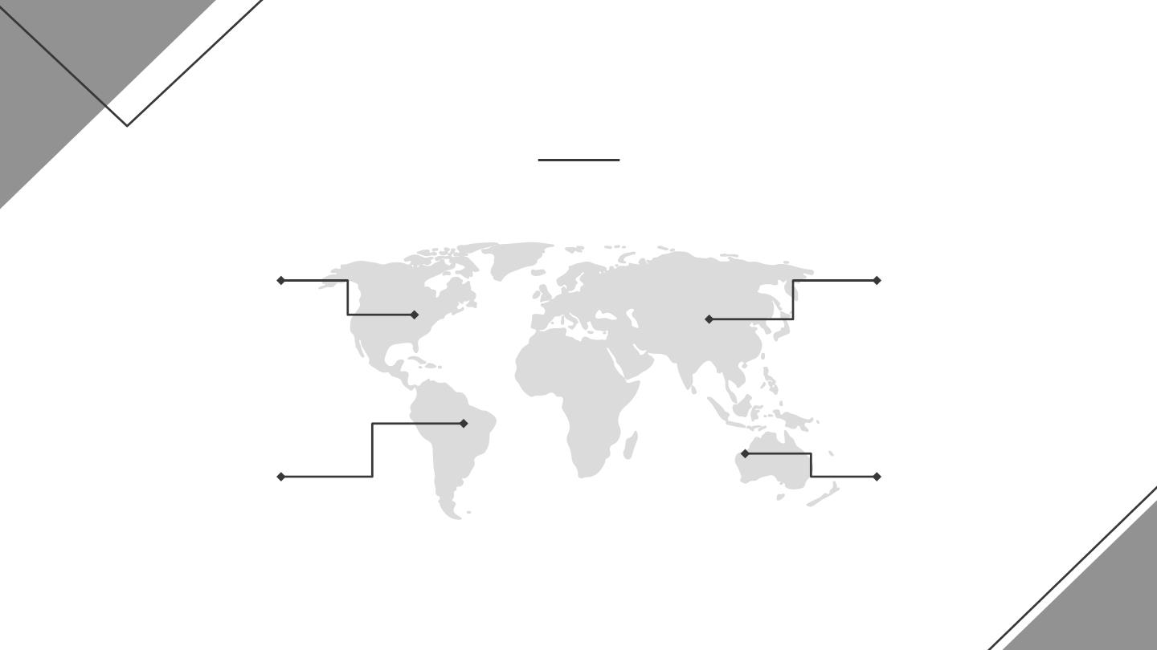
Market size
20%
40%
Mercury
Venus
Mercury is the
smallest planet
Venus has a
beautiful name
30%
10%
Jupiter
Mars
Jupiter is the
biggest planet
Mars is a very
cold place

Slide 45
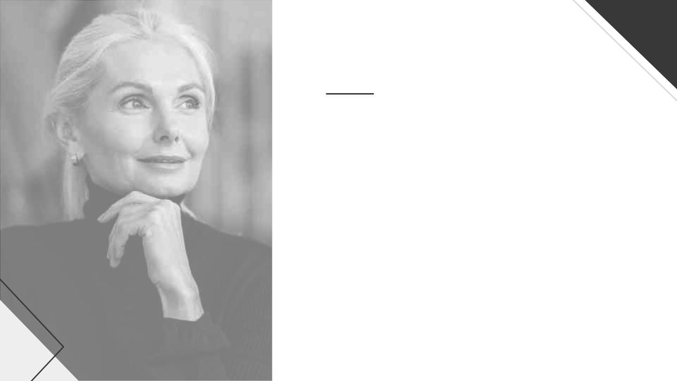
Our target
Job
Age
Interior
50-60
Designer
Gender
Salary
Female
$15,000
Interests
Shopping
Reading
Average spent
$80,00
Trends

Slide 46
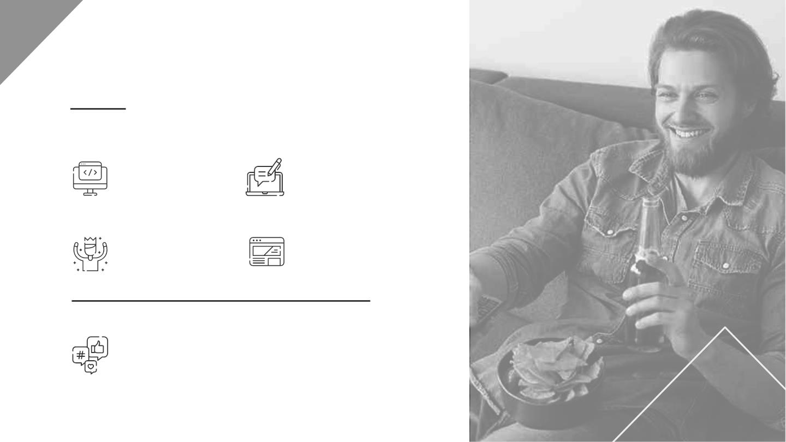
Our target
Job
Age
Informatic
35 - 45
Gender
Salary
Male
$12,000
Interests
● Music
● Sports
● Dance
● Sports

Slide 47
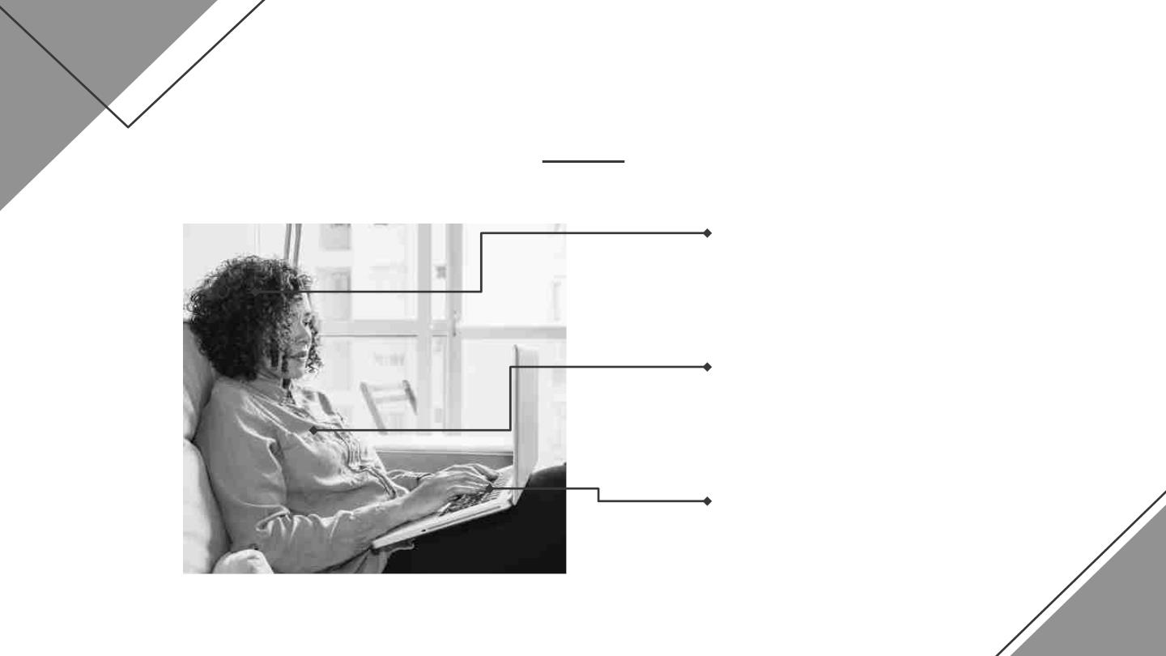
Buyer journey
Awareness
Jupiter is a gas giant and
the biggest planet
Consideration
Mercury is the closest
planet to the Sun
Decision
Venus has a beautiful
name, but it’s terribly hot

Slide 48
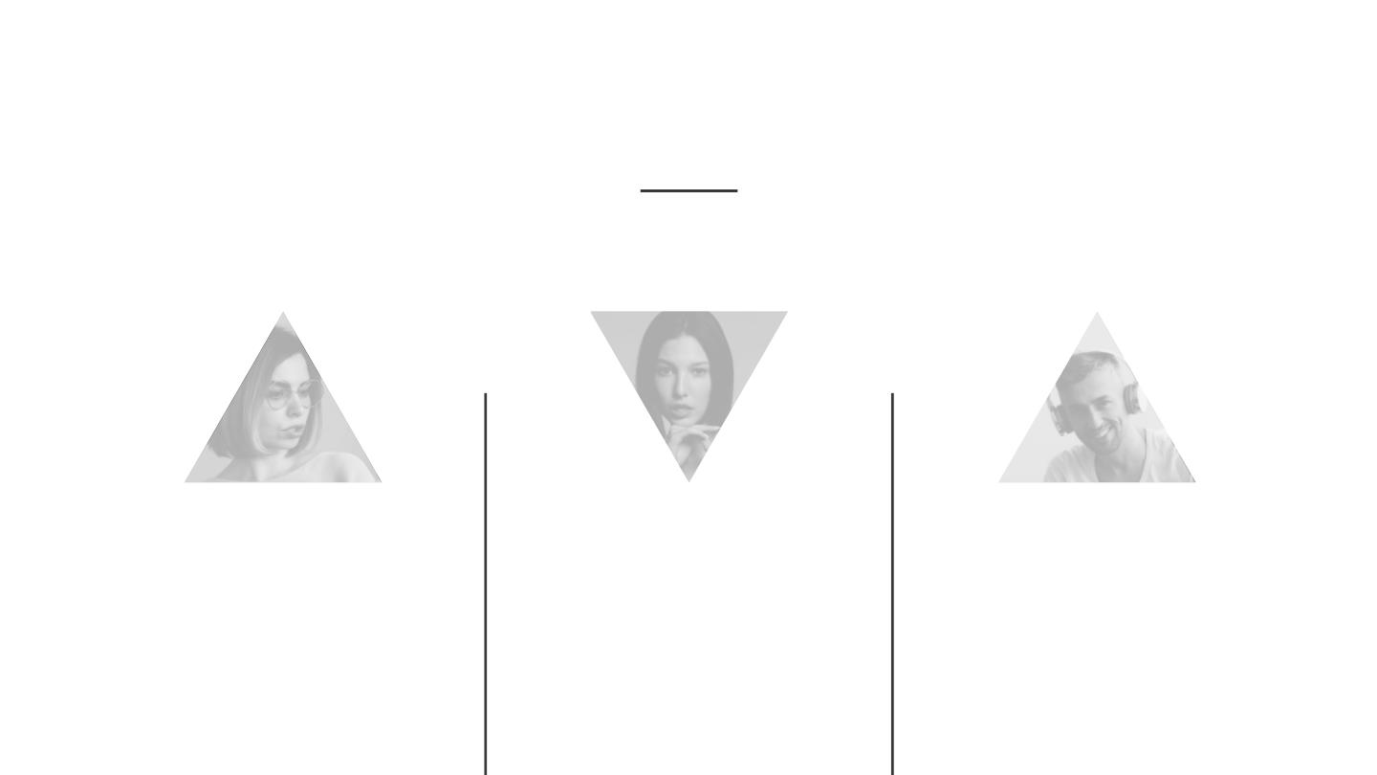
Competitors
Mars
Jupiter
Saturn
Despite being red,
Mars is actually a
cold place
Jupiter is a gas giant
and the biggest
Saturn is composed
mostly of hydrogen
and helium
planet of them all

Slide 49
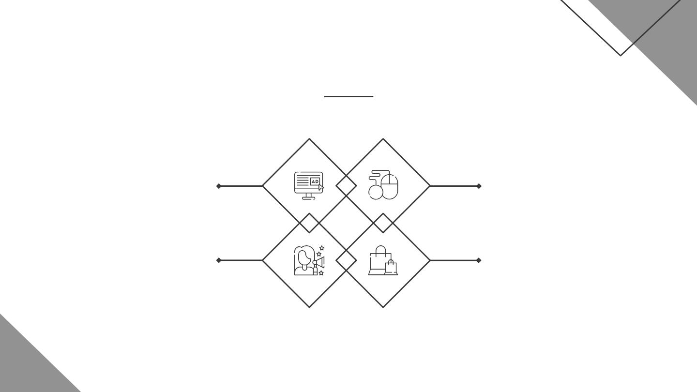
Competitors
Venus
Jupiter
Venus is the second
planet from the Sun
Jupiter is a gas giant
and the biggest planet
Saturn
Mars
Saturn is composed of
hydrogen and helium
Despite being red,
Mars is a cold place

Slide 50
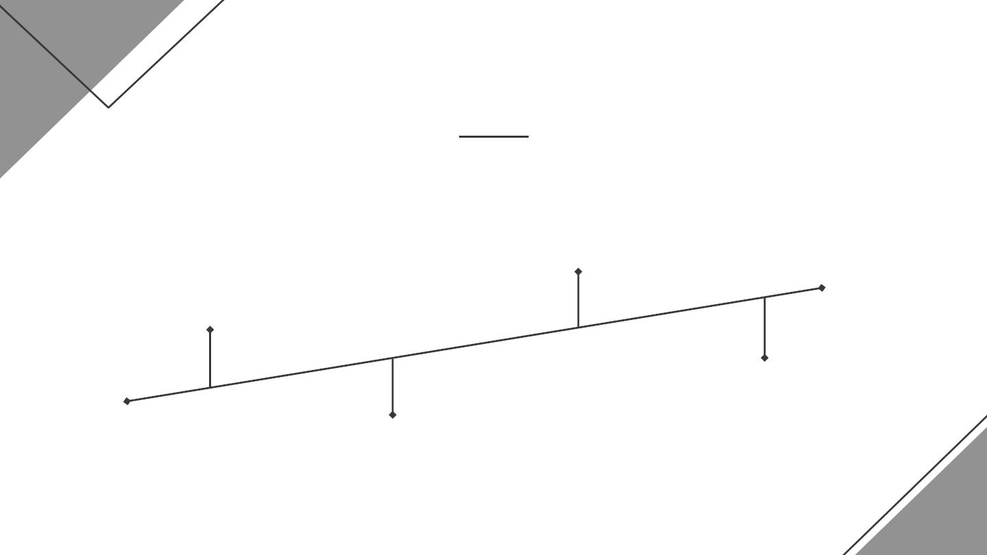
Our business model
Marketing
Neptune is far
away from us
Technology
Saturn is the
ringed planet
Training
Mercury is a
small planet
Assessment
Venus has a
nice name

Slide 51
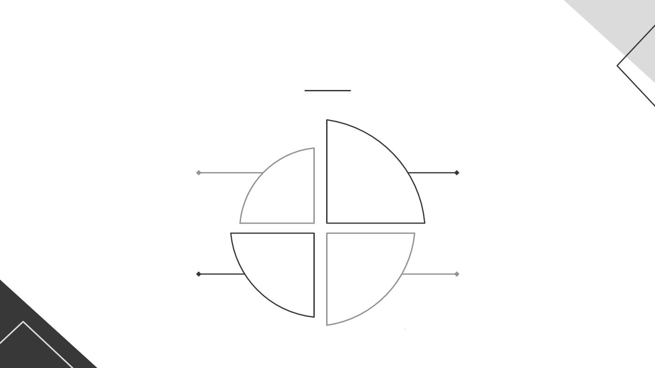
Our business model
Technology
MarketinG
Venus has a beautiful
name, but it’s hot
Despite being red,
Mars is a cold place
Assessment
Training
Mercury is the closest
planet to the Sun
Jupiter is the biggest
planet of them all

Slide 52
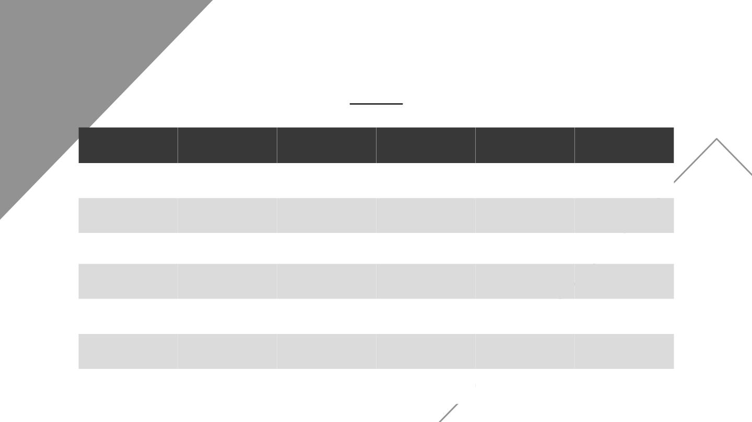
Schedule
Time
Mon
Tue
Wed
Thu
Fri
09:00 -
10:00
10:00 -
11:00
Meeting
Home office Home office
Meeting
Brunch
Meeting
11:00 - 11:30
Project
Meeting
11:30 -
12:30
Accounting
12:30 -
13:30
13:30 -
14:30
Project
Lunch
Meeting
Lunch
Project
Lunch
Lunch
Lunch
14:30 -
15:30
Accounting
Meeting

Slide 53
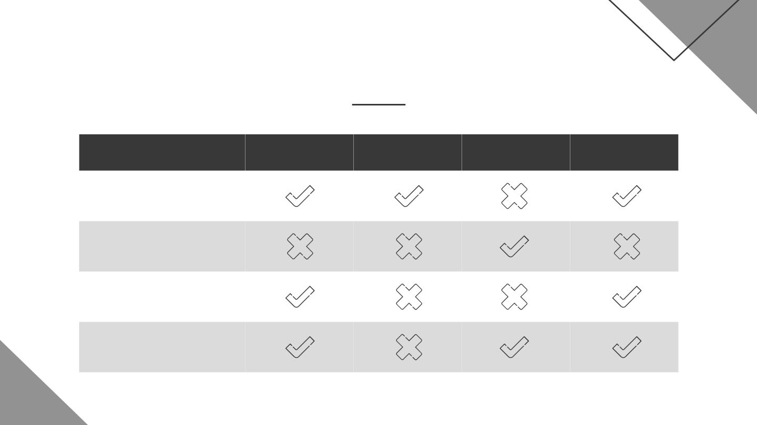
Competitor analysis
Mars
Venus
Mercury
Jupiter
Despite being red,
Mars is a cold place
Venus has a beautiful
name, but it’s hot
Mercury is the closest
planet to the Sun
Jupiter is the biggest
planet of them all

Slide 54

Predicted growth
20,000 100 500
Expected customers
New employees
Upcoming projects

Slide 55
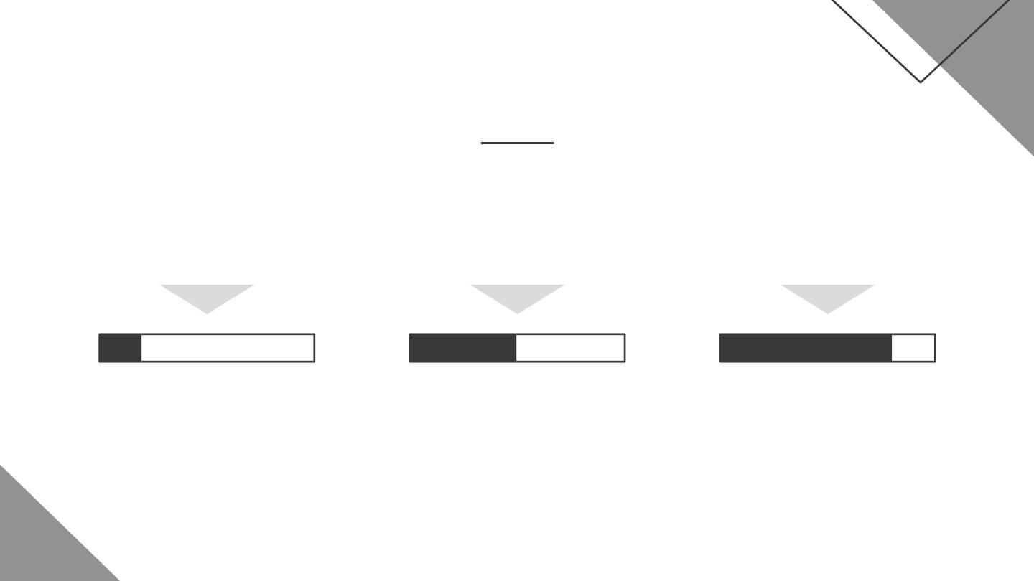
Predicted growth
25%
50%
75%
Venus
Mars
jupiter
Venus has a beautiful
name, but it’s hot
Despite being red,
Mars is a cold place
Jupiter is the biggest
planet of them all

Slide 56

333,000
earths is the Sun’s mass
9h 55m 23s
is Jupiter’s rotation period
386,000 km
is the distance between Earth and the Moon

Slide 57

$90,000
Expected income

Slide 58
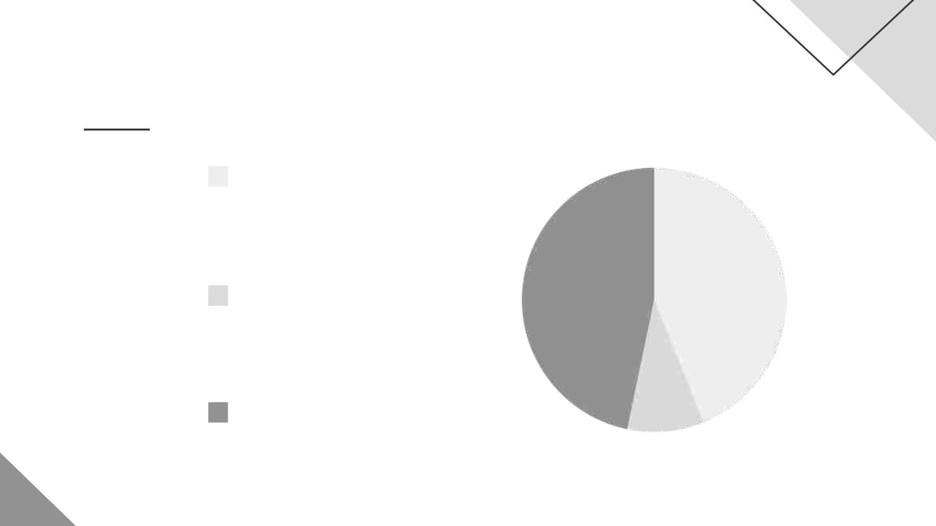
Investment
45%
Mercury
Mercury is the closest
planet to the Sun
Mars
10%
45%
Despite being red,
Mars is a cold place
Jupiter
Jupiter is the biggest
planet of them all
To modify this graph, click on it, follow the link, change the
data and paste the new graph here

Slide 59


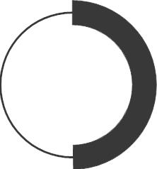
Investment
25%
50%
75%
mercury
MARS
JUPITER
Mercury is the
Despite being red,
Mars is a cold place
Jupiter is the biggest
planet of them all
closest planet to the
Sun

Slide 60
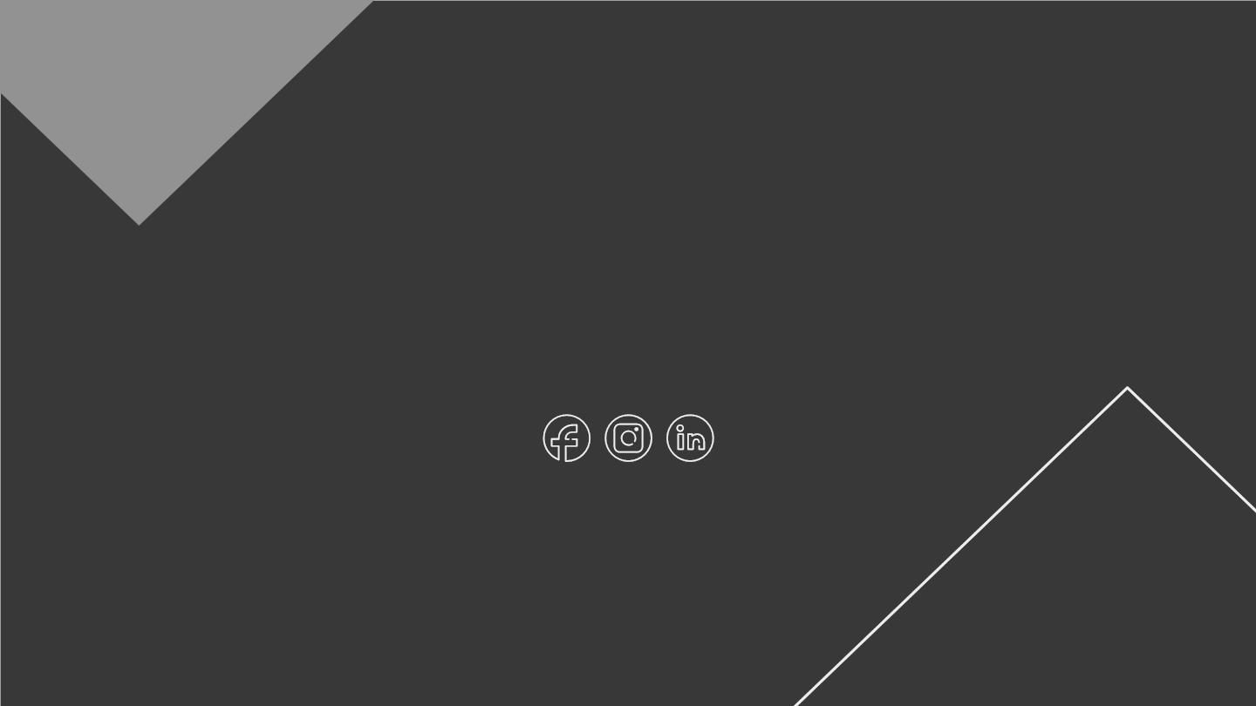
Thanks
Do you have any questions?
addyouremail@freepik.com
+91 620 421 838
yourcompany.com
CREDITS: This presentation template was created by
minmallist, including icons by Flaticon, infographics & images
Please keep t^{b}h^{y}is^{F r}s^{e}l^{e}id^{p}e^{ik} for attribution

Slide 61
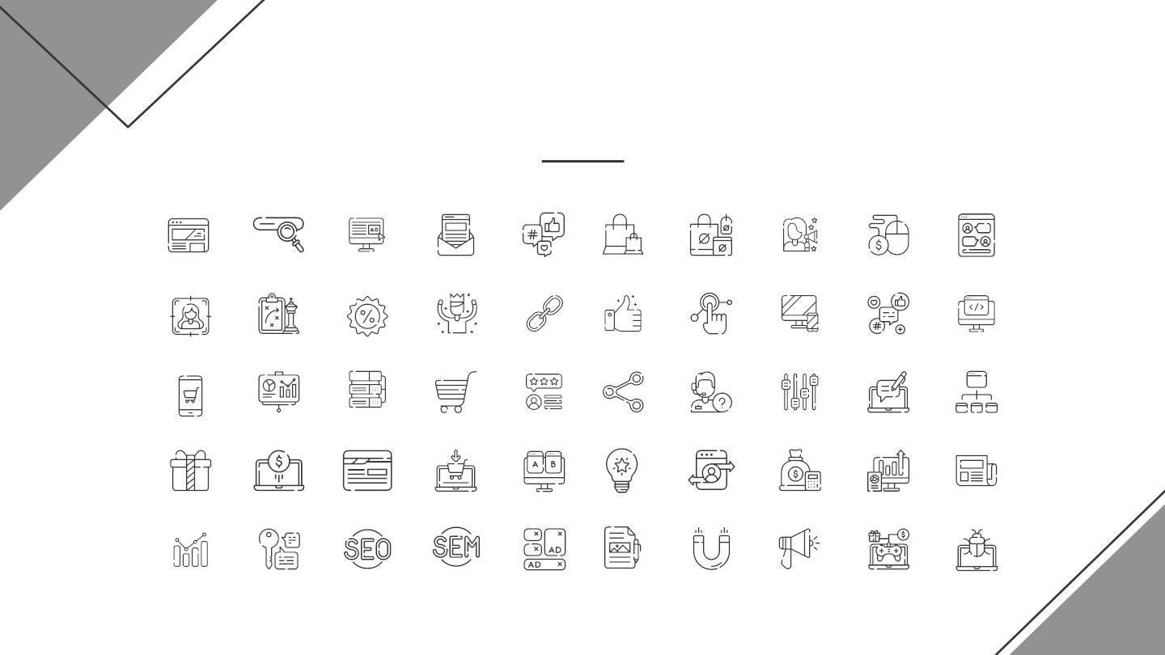
Online marketing pack

Slide 62

Alternative resources
● Woman at desk working from home
● Mid shot woman at laptop
● Worried woman looking at phone
● Woman jumping and holding a camera
● African american man high view
● Girls dancing
● Front view guy with headphones holding a cup of coffee
● African american man reading his notes close-up
● Adorable model holding glasses

Slide 63

Alternative resources
● Thoughtful young man looking at digital tablet on kitchen counter
● Happy young african businesswoman holding clipboard in hand looking away
● Young office team coworking
● Multiracial group of coworkers listening to speaker
● Multiracial group of coworkers laughing together
● Group of businesspeople looking at business plan in the office
● Man and woman walking together at dealership
● Long shot of business people in meeting
● Low angle womens team meeting
● Colleagues working together at the office
● Business people working on a new project in the office
● Female colleagues discussing work at office
● Stressed young businessman sitting at workplace in the office
● Group of adult men working together at the office

Slide 64
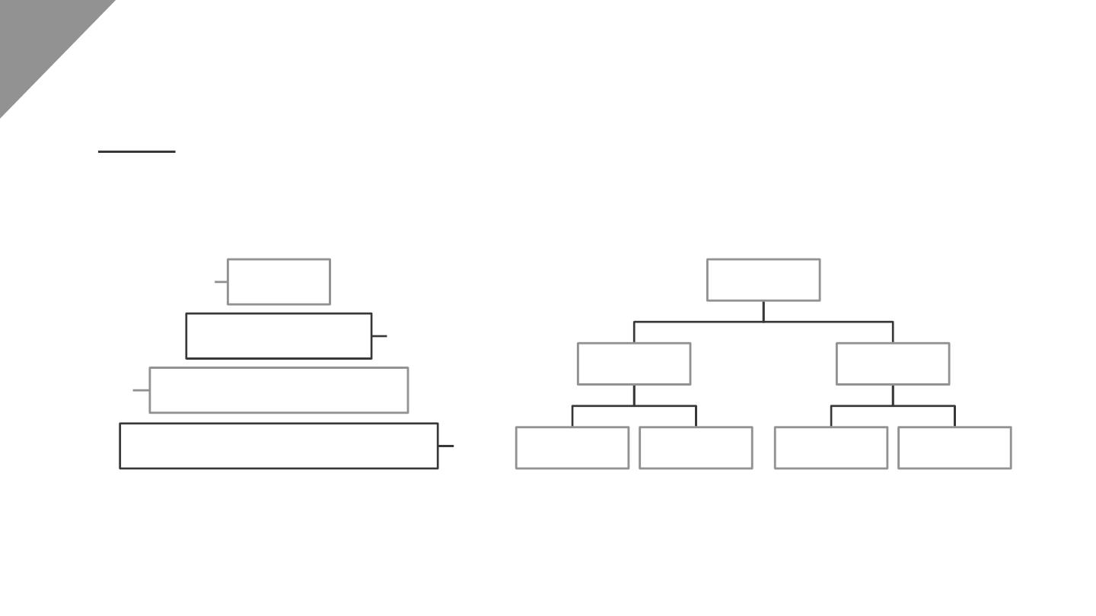
Alternative resources

Slide 65
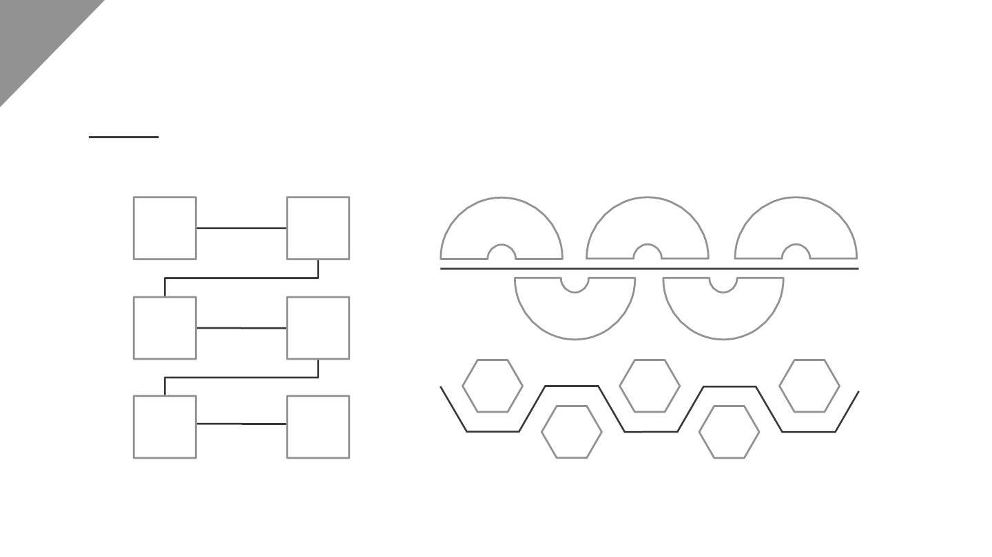
Alternative resources

Slide 66
Resources
● Man with black jacket talking on a phone and drinking
● Woman jumping and using her camera photo
● Alluring woman posing in yellow top
● African american man copy space
● Man posing with arms crossed
● Woman holding a camera photo
● Side view of male photographer
● African american man writing
● Man with black jacket talking on the phone
● African american man front view
● Young girl speaking on the phone in the office
● Young man wearing eyeglasses using laptop on kitchen counter
● Mid shot woman talking on phone at table

Slide 67
Resources
● Front view of older woman working with pen
● Stylish model pointing at phone
● Studio shot of woman posing
● Guy sitting on a chair and holding a digital tablet
● Portrait freelance woman working from home
● Front view of businesswoman working with laptop and notebook

Slide 68
Resources
● Business woman working at home
● Portrait young man wearing shirt posing
● Blonde businesswoman working on a laptop
● Front view of smiley woman holding a tablet
● Contemplating businesswoman sitting in front of laptop in office
● Friendly brunette looking at camera
● Medium shot man watching tv at home
● Office studio and photographer taking photos
● Teamwork meeting with business people
● Cheerful coworkers at table with gadgets
● Colleagues looking at charts
● Portrait of a male psychologist sitting on chair writing in diary with pencil looking at
camera

Slide 69

Instructions for use (premium users)
As a Premium user, you can use this template without attributingminmallist or keeping the "Thanks" slide.
You are allowed to:
●
●
●
●
Modify this template.
Use it for both personal and commercial purposes.
Hide or delete the “Thanks” slide and the mention tominmallist in the credits.
Share this template in an editable format with people who are not part of your team.
You are not allowed to:
●
●
Sublicense, sell or rent this minmallist Template (or a modified version of this minmallist Template).
Distribute this minmallist Template (or a modified version of this minmallist Template) or include it in a database or
in any other product or service that offers downloadable images, icons or presentations that may be subject to
distribution or resale.
●
●
Use any of the elements that are part of thisminmallist Template in an isolated and separated way from this
Template.
Register any of the elements that are part of this template as a trademark or logo, or register it as a work in an
intellectual property registry or similar.
For more information about editing slides, please readour FAQs or visit minmallist School:
https://slidesgo.com/faqs and https://slidesgo.com/slidesgo-school

Slide 70
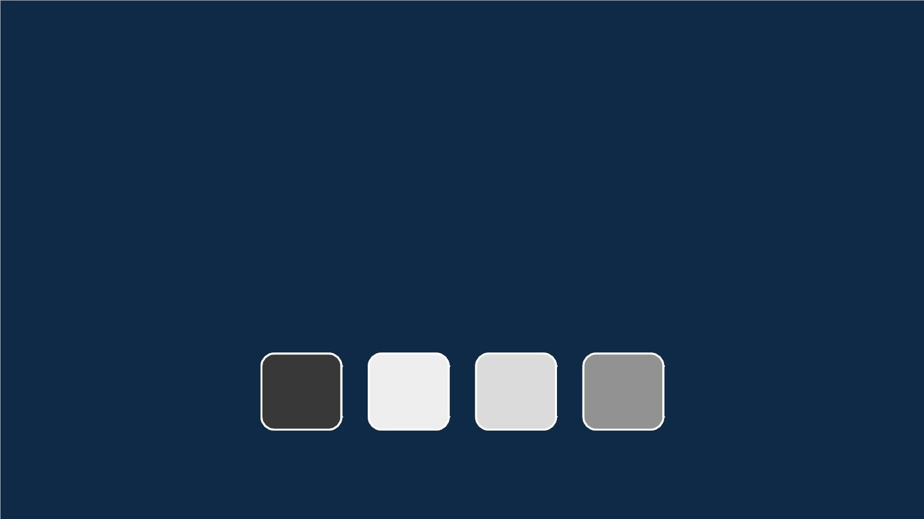
Fonts & colors used
This presentation has been made using the following fonts:
Julius Sans One
(https://fonts.google.com/specimen/Julius+Sans+One)
Didact Gothic
(https://fonts.google.com/specimen/Didact+Gothic)
#383838
#eeeeee
#dbdbdb
#929292

Slide 71
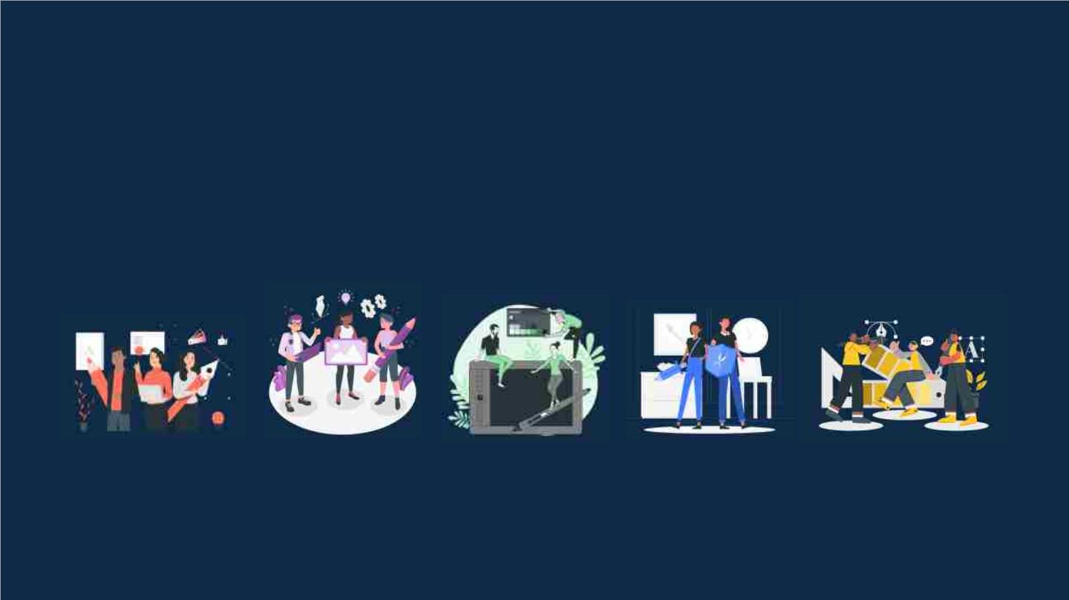
Storyset
Create your Story with our illustrated concepts. Choose the style you like the most, edit its colors, pick
the background and layers you want to show and bring them to life with the animator panel! It will boost
your presentation. Check out how it works.
Pana
Amico
Bro
Rafiki
Cuate

Slide 72
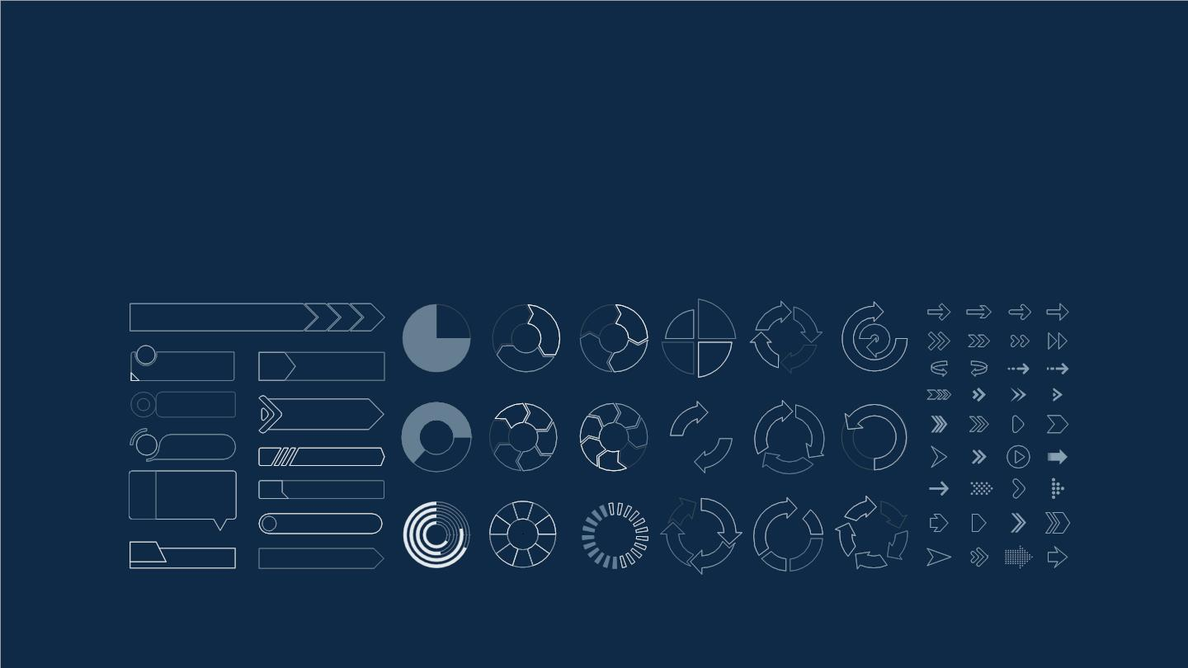
Use our editable graphic resources...
You can easily resize these resources without losing quality. To change the color, just ungroup the resource
and click on the object you want to change. Then, click on the paint bucket and select the color you want.
Group the resource again when you’re done. You can also look for more infographics on minmallist.

Slide 73
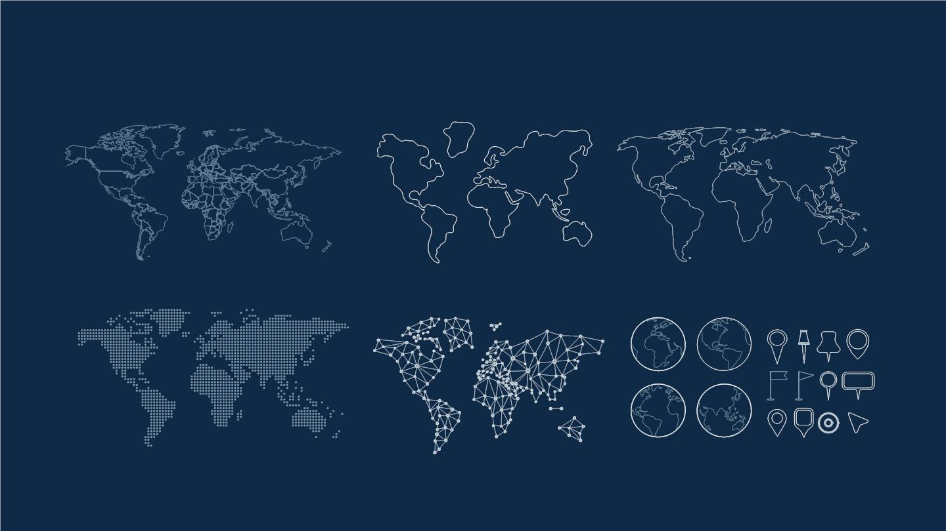

Slide 74
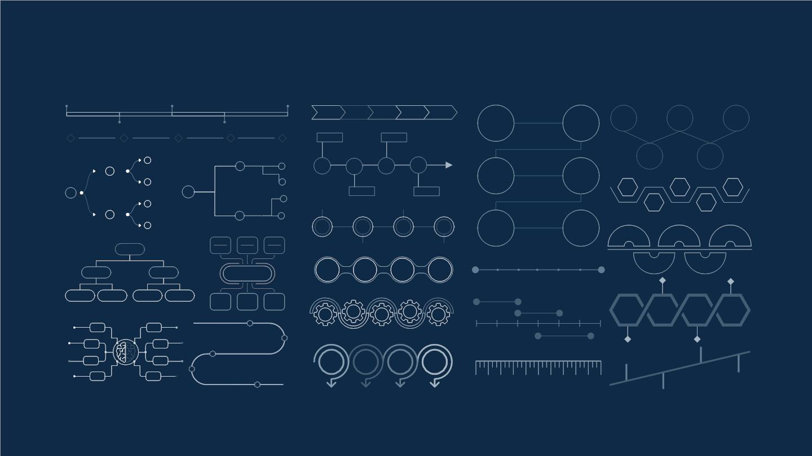

Slide 75
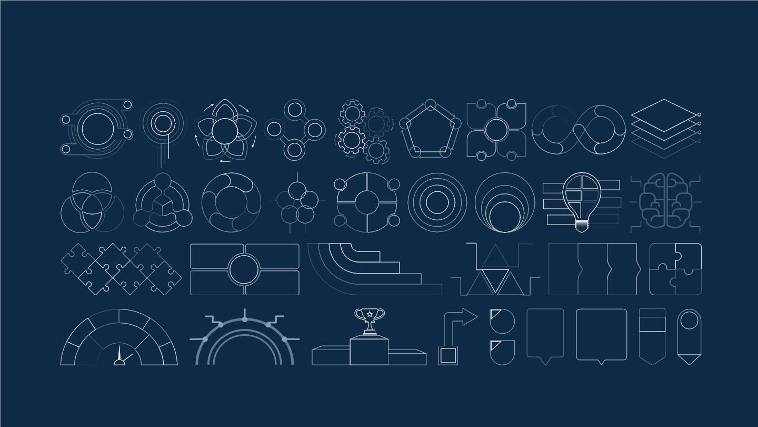

Slide 76
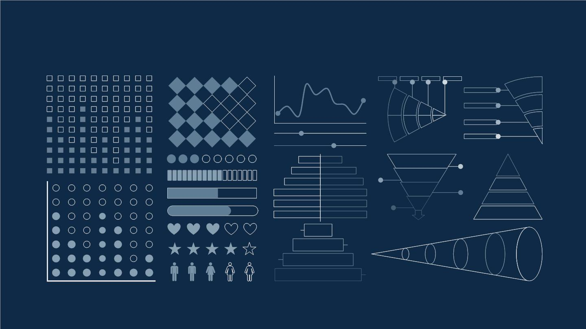

Slide 77

...and our sets of editable icons
You can resize these icons without losing quality.
You can change the stroke and fill color; just select the icon and click on the paint bucket/pen.
In Google Slides, you can also use Flaticon’s extension, allowing you to customize and add even more icons.

Slide 78
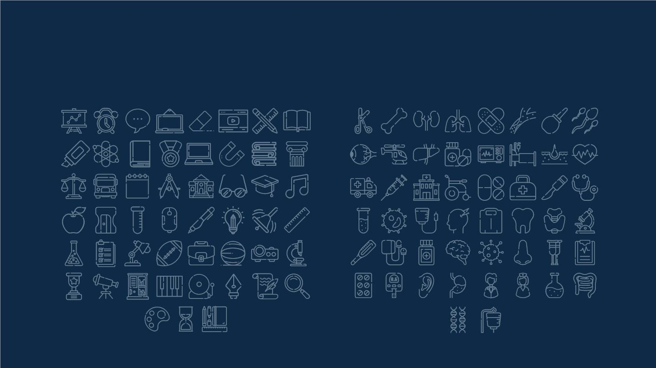
Educational Icons
Medical Icons

Slide 79

Business Icons
Teamwork Icons

Slide 80
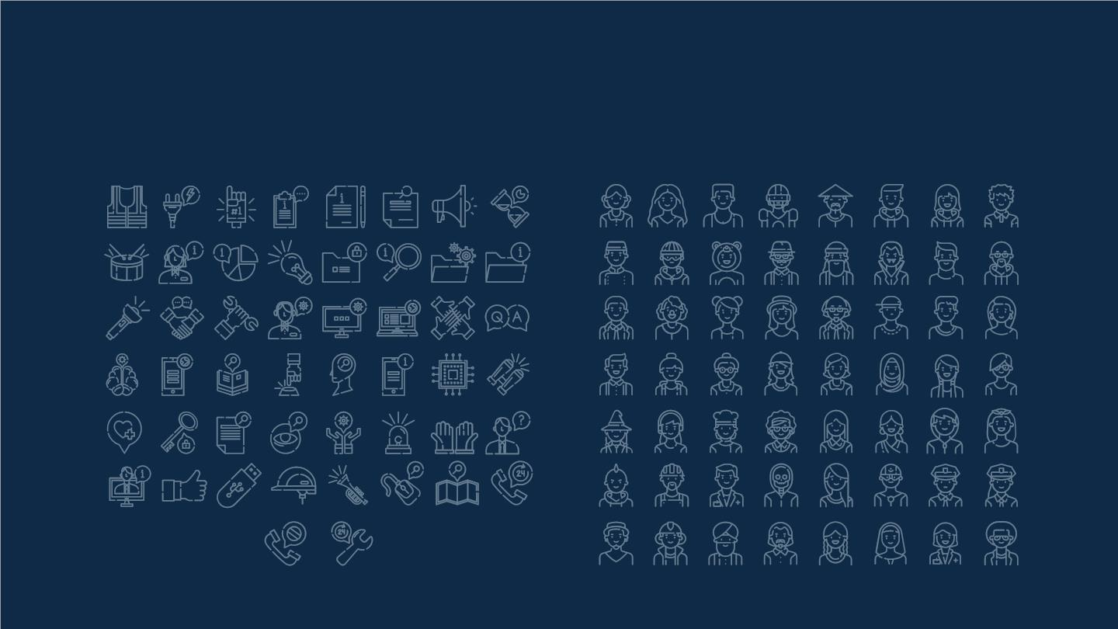
Help & Support Icons
Avatar Icons

Slide 81
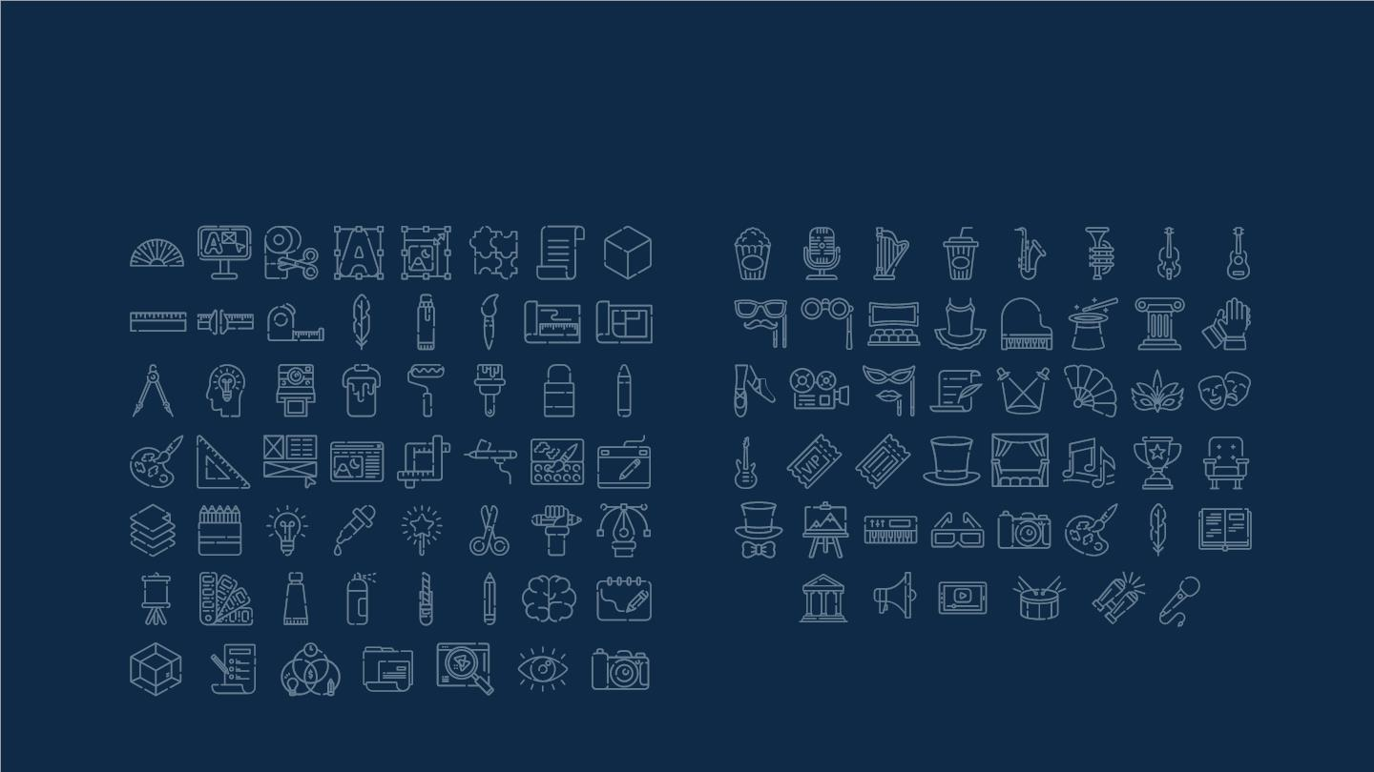
Creative Process Icons
Performing Arts Icons

Slide 82
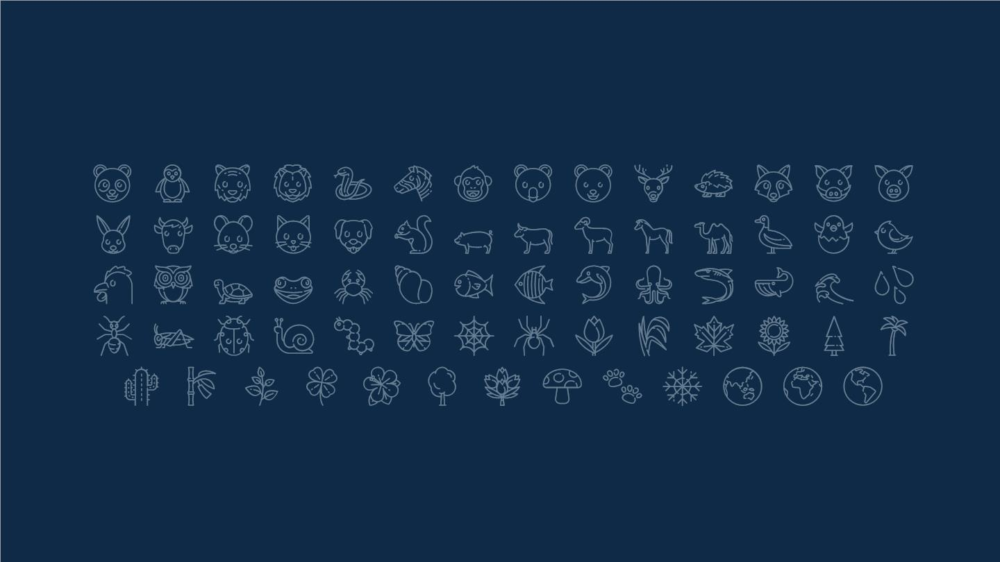
Nature Icons

Slide 83

SEO & Marketing Icons

Slide 84
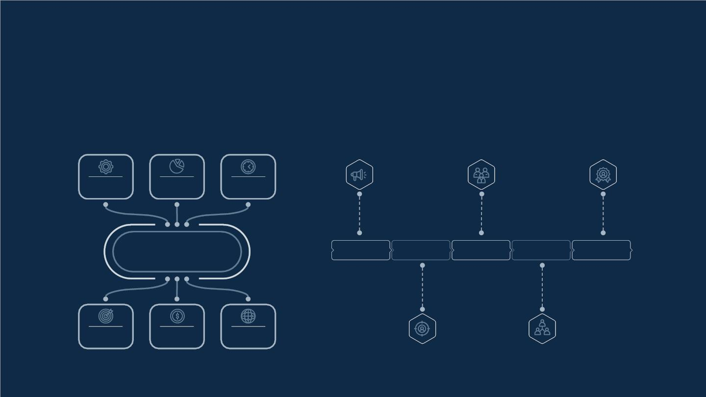
Premium infographics
Text 1
Text 2
Text 3
“Mercury is closest
planet to the Sun
and the smallest”
“Despite being red,
Mars is a cold place
full of iron oxide”
Add the Title here
2016
2017
2018
2019
2020
“Venus has a
beautiful name and
is the second planet”
“Neptune is the
farthest-known
planet from the Sun”
“Saturn is a gas
giant and has
several rings”
Text 4
Text 5
Text 6

Slide 85

Premium infographics
75%
“Mercury is closest
planet to the Sun
and the smallest”
TITLE 1
75%
“Mercury is closest
planet to the Sun
and the smallest”
“Mercury is closest
planet to the Sun
and the smallest”
“Mercury is closest
planet to the Sun
and the smallest”

Slide 86

Premium Icons
Digital Marketing

Slide 87

Premium Icons
Online Learning

Slide 88

Premium Icons
Laboratory

Slide 89

Premium Icons
Goals and Results

Slide 90

Premium Icons
Infographics Elements

